Slide 1

DIAGNOSING CHRONIC KIDNEY DISEASE USING MACHINE LEARNING
Batch No: B-14 Project Guide:
Swetha.J (174g1a0596) Mr. C.SUDHEER KUMAR, M.Tech.
Rekha.S (164g1a0580) Assistant Professor
Sai Krishna.K (174g1a0568)
Bharath.K (174g1a05c0)
Srinivasa Ramanujan Institute of Technology
Department of Computer Science & Engineering

Slide 2
Introduction
Kidney is important part of human body.
Chronic kidney disease is a global public health problem.
It slow deterioration in renal function.
CKD does not show obvious symptoms in its early stages.
Glomerular filtration rate(GFR) and ACR test is taken to find out Chronic kidney disease(CKD).
Kidney biopsy taken place to find out Chronic kidney disease.
Disadvantage is CKD can’t be identified in early stage.
Existing System

Slide 3
Proposing System
To overcome issue of not identifying Chronic kidney disease in early stage we proposed a solution using Machine learning, by taking parameters(Sugar, Diabetes, Blood pressure…)and detect whether patient has Chronic kidney disease or not.

Slide 4
Abstract
Chronic kidney disease (CKD) is a global health problem with high morbidity and mortality rate, and it induces other diseases. Since there are no obvious symptoms during the early stages of CKD, patients often fail to notice the disease. Early detection of CKD enables patients to receive timely treatment to better the progression of this disease. To achieve this machine learning model is used.
Machine learning model can effectively aid clinicians achieve this goal due to their fast and accurate recognition performance. The Chronic kidney disease data set are obtained, machine learning algorithm Random Forest were used to establish model and KNN imputation in filling missing values of dataset, that could be applicable to more complicated clinical data for disease diagnosis.

Slide 5
Problem Definition :
In today's era everyone is trying to be conscious about health although due to workload and busy schedule one gives attention to the health when it shows any symptoms of some kind. But CKD is a disease which doesn't shows symptoms at all or in some cases it doesn't show any disease specific symptoms it is hard to predict, detect and prevent such a disease and this could be lead to permanently health damage.
For this we are using Machine learning Algorithm Random Forest in order to predict whether a individual has Chronic kidney disease(CKD) or not and in this KNN imputation is used for filling missing values of dataset.

Slide 6
Random Forest
Random Forest Algorithm belongs to the supervised learning technique.
It is based on the concept of ensemble learning, which is a process of combining multiple classifiers to solve a complex problem and to improve the performance of the model.
Instead of relying on one decision tree, the random forest takes the prediction from each tree and based on the majority votes of predictions, and it predicts the final output.

Slide 7
System Architecture
dataset
Data Preprocessing
Preprocessed data
Machine learning
algorithm
User input
Disease Prediction Model
Predicted Result

Slide 8
Cont...
The main components of the application are:
1) Front-End Interface
2) Server
3) Random Forest Model
4) End Result (Display Screen)

Slide 9
Cont…
Front-End Interface is a web page where dataset is uploaded and input values are taken from user.
Server is the back-end of the application which maintains the connection with front-end interface, model and display screen.
Server reads the input which is provided by the user and provides the input array as an input to the Random Forest model.

Slide 10
Cont…
The Random Forest model classifies whether the Patient has Chronic Kidney Disease or not.
The result will be displayed on the display screen.

Slide 11

Result

Slide 12
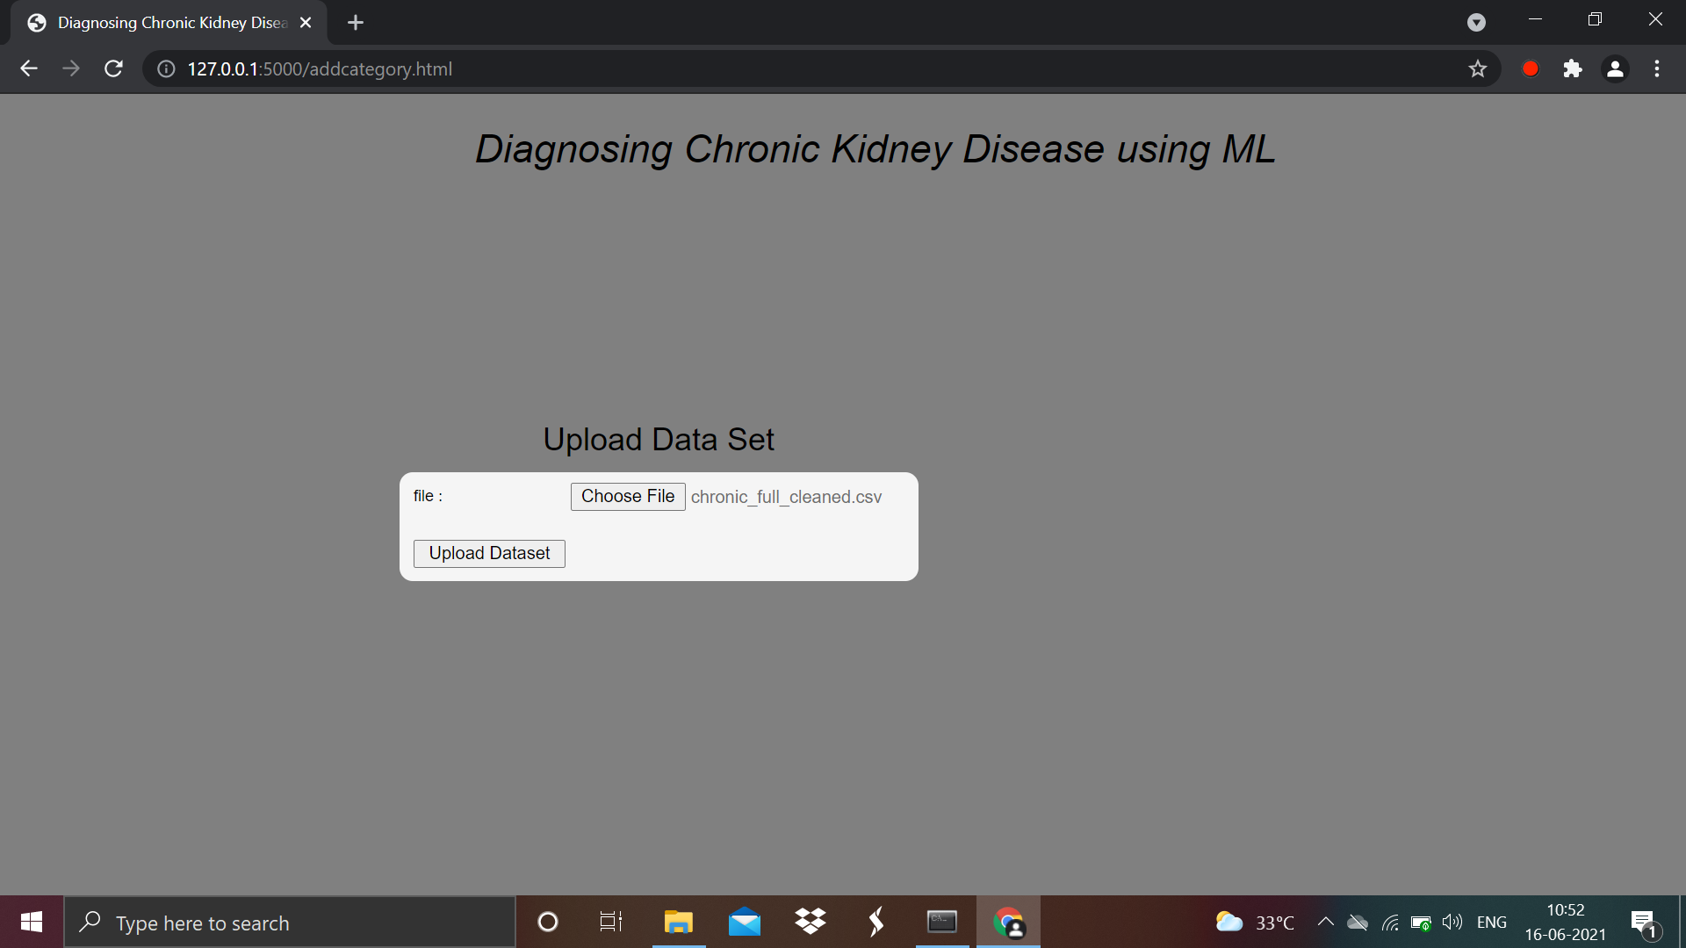
Upload file

Slide 13
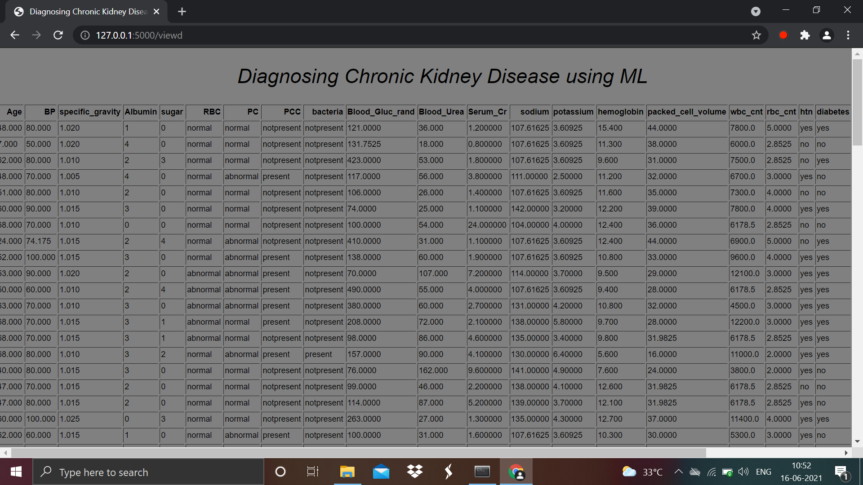
Dataset

Slide 14
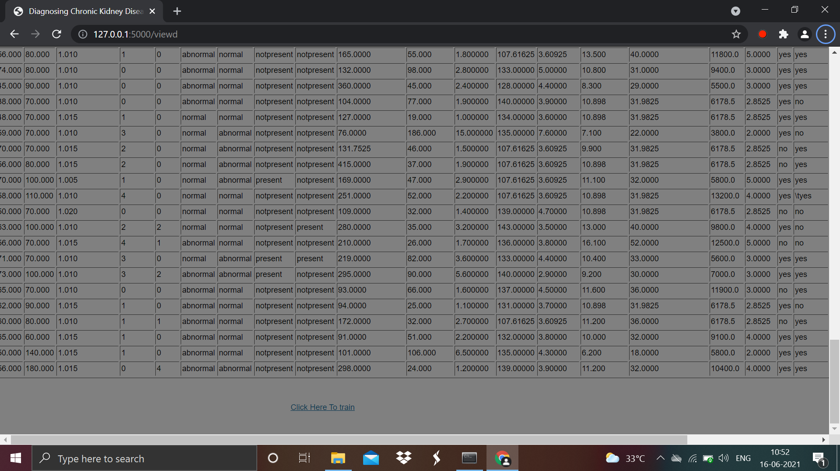
Click on train

Slide 15
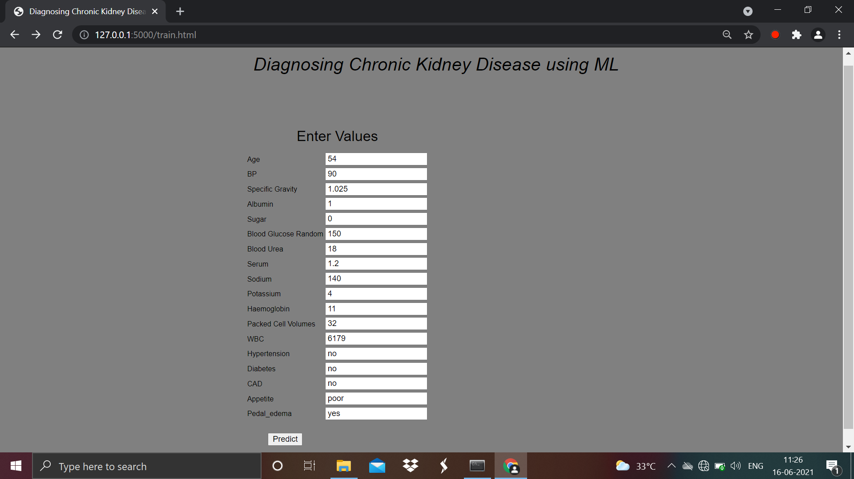
Input

Slide 16

Output

Slide 17
Conclusion
The Project predicts whether Patient has Chronic Kidney Disease or the Patient don’t have Chronic Kidney Disease.

Slide 18
Literature Survey
[Luxia Zhang , Fang Wang, Li Wang] cross-sectional survey of a nationally representative sample of Chinese adults. Chronic kidney disease was defined as eGFR less than 60 mL/min per 1·73 m(2) or the presence of albuminuria. Participants completed a lifestyle and medical history questionnaire and had their blood pressure measured, and blood and urine samples taken. Serum creatinine was measured and used to estimate glomerular filtration rate. Urinary albumin and creatinine were tested to assess albuminuria. The crude and adjusted prevalence of indicators of kidney damage were calculated and factors associated with the presence of chronic kidney disease.

Slide 19
Continued…
[C. Barbieri et al., ]Fluid volume and blood pressure (BP) management are crucial clinical performance indicators of dialysis adequacy in end-stage kidney disease (ESKD) patients. The prevalence of hypertension among ESKD patients ranges between 40 and 90% according to the BP definition used, the population selected, and the timing of measurement [1, 2].

Slide 20
References:
[1] L. Zhang et al., “Prevalence of chronic kidney disease in china: a crosssectional survey,” Lancet, vol. 379, pp. 815-822, Aug. 2012.
[2] C. Barbieri et al., “A new machine learning approach for predicting the response to anemia treatment in a large cohort of end stage renal disease patients undergoing dialysis,” Comput. Biol. Med., vol. 61, pp. 56-61, Jun. 2015.

Slide 21
Thank you
Queries
?

